Slide 1



Introduction to AWS
Bergen Cloud User Group - 2020.09.15
Using Amazon Web Services (AWS)

Slide 2
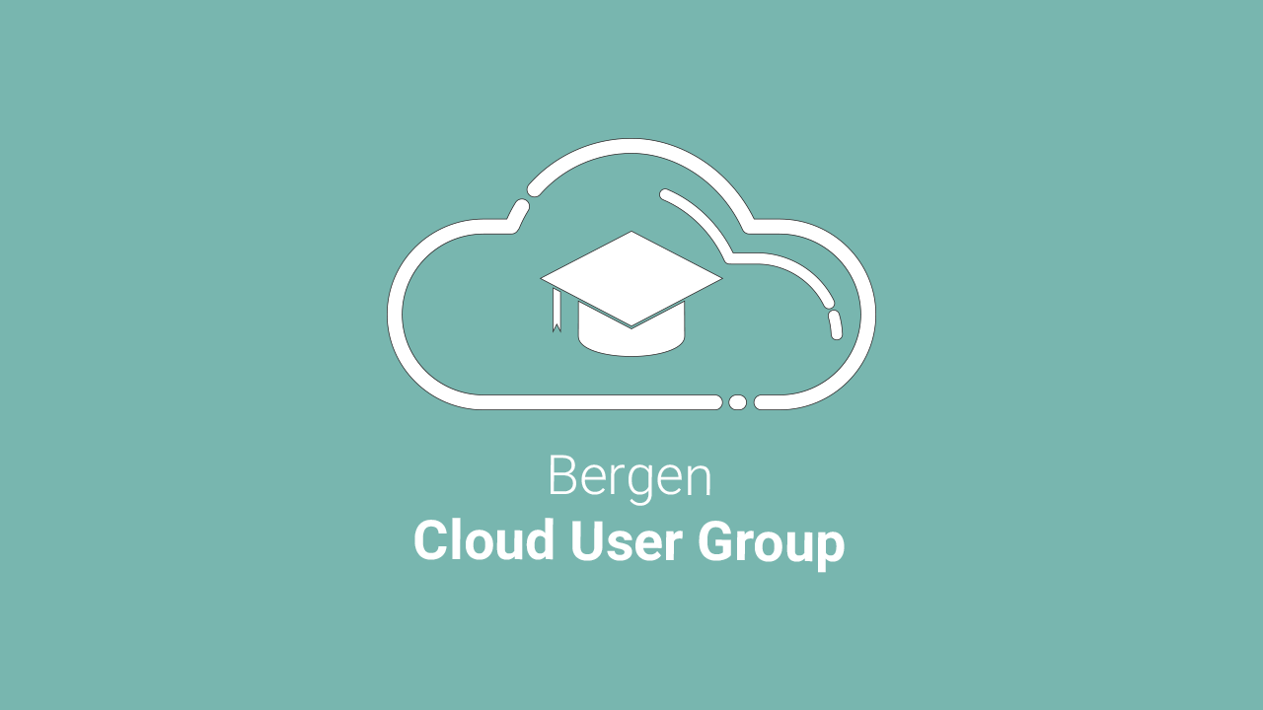


Slide 3

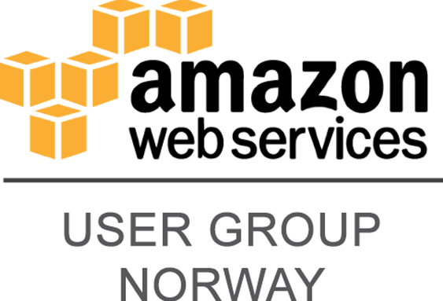


Nerdschool

Slide 4

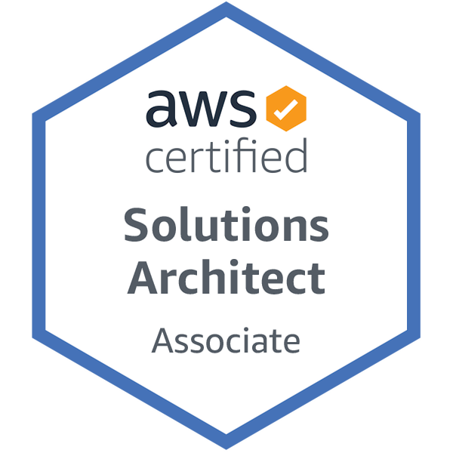
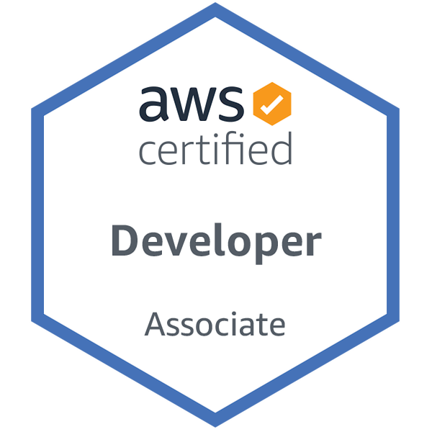


Karl Mathias Moberg
About me
Bergen, Norway 🇳🇴
Cloud Consultant @ TietoEVRY
AWS Certified Solutions Architect & Developer
30 Years old, 2 Kids
♥️ DevOps
Developer, Photographer, Aviation Geek ✈️
@mathiasmoberg
kmoberg

Slide 5

What is Cloud Computing?

Slide 6


Source: https://bit.ly/visiblecloud
“Due to less Pollution, the files stored on cloud are now Clearly Visible. 🙃”
@Shah_Rizvi97, 2020.05.05

Slide 7

“There is no cloud, it’s just someone else’s computer”
- The internet

Slide 8



What?
Cloud Computing - Amazon Web Services
Traditional Business
Servers
Cloud
Virtualized Environment
Notes:
Went from:
Traditional server farm
One service per server
Lots and lots of low-specced servers consuming a LOT of energy and taking up a LOT of space.
Extremely low efficiency per server. CPU Util often in 20% range.
VERY long lead times for new servers or services.
Moved to:
Virtualization!
Fewer high-specced servers
Much better util. Closer to 80-90%.
Virtual Machines
Often longer lead times to deploy new virtualization hosts.
Extremely high up-front costs.
Future:
Cloud!
Pioneered by Salesforce , AWS launched in 2002.
In practice, unlimited potential CPU and Storage capacity
No up-front costs.
Near instant deployment
Number of PaaS solutions, no need for entire OS anymore.
Managed Services - no need to maintain servers.
MUCH better security - don’t fool yourself. AWS is better than you at security IF you follow their instructions.

Slide 9

“Our move to the cloud costs how much per month??”
- Executives after they see their cloud bill, a month after lifting 100 servers to the cloud
Notes:
Moving to the cloud is NOT cheaper using “lift and shift”.
You need to consider what you are putting in the cloud and how you do it. Most traditional server deployments are much more expensive in the cloud, than the cloud-native solutions.
Example: AcloudGuru

Slide 10



Why?
Cloud Computing - Amazon Web Services
Elasticity
Efficiency
Strategic Value
Notes:
Elasticity or Flexibility:
Scalability
Storage Options
Control Choices
Tool Selection
SECURITY FEATURES
Efficiency:
Accessibility
Speed to market
Data security
Savings on equipment
Pay as you go
Strategic Value:
Cloud Provider manage infrastructure, allowing business to focus on app development
Regular updates
Collaboration
No upfront-costs, pay as you go, easier to get started.
Global distribution in minutes

Slide 11

What is Cloud Computing?

Slide 12

Acronym-Extravaganza
Cloud Computing - Amazon Web Services
Types of Cloud Services
IaaS - Infrastructure as a Service Technical infrastructure maintained by provider, such as Networking, Physical Machines, Power, etc.
PaaS - Platform as a Service Focus on the code and not about the server, operating system and storage.
SaaS - Software as a Service Complete software packages, run and maintained by provider.
XaaS - <You Name It> as a Service Backup as a service? Sure! 🍕aaS? Why not?
Notes:
IaaS - AWS, Azure, GCP, Digital Ocean
PaaS - AWS Elastic Beanstalk, Google App Engine, RedHat OpenShift,
SaaS - Office 365, G-Suite, Salesforce, Adobe Creative Cloud, Survey Monkey, Slack
XaaS - TONS of other names, Backup, Networking, Containers, Desktop, Pizza.

Slide 13



Deployment
Cloud Computing - Amazon Web Services
Private Cloud
Hybrid Cloud
Public Cloud
Notes:
Private Cloud - “On-Prem”:
All Infrastructure in on-prem at the client, or with a private service provider.
Many or most applications are only available if on-prem or via VPN.
Long Deployment Times for new hardware, or servers.
Security - for companies that have highly sensitive data.
Hybrid Cloud:
Mix of both worlds - servers both on-prem and in the cloud.
On-Prem kan help speed up applications that are locally needed.
Can benefit from cloud deployment speed.
Can be haltered by some applications not being able to scale to the cloud.
Allows for longer migration periods for existing companies.
… Security?
Can be expensive!
Public Cloud:
Perfect for startups and companies with little or no technical debt.
Eslasticity, instant deployments, speed.
Perfect for SaaS Companies that need the ability to scale quickly
No up-front costs.

Slide 14
Amazon Web Services

Slide 15

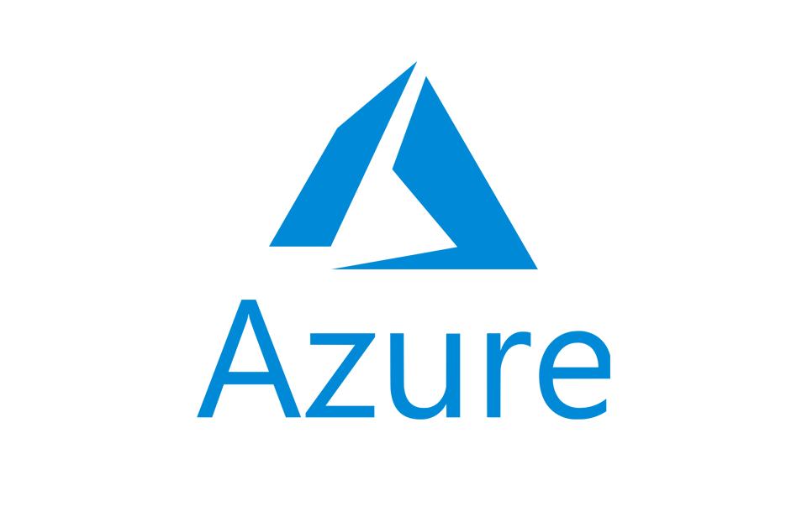

Cloud Providers
Cloud Computing - Amazon Web Services

Slide 16
32.4%
AWS Q4 2019 Marketshare
Source: Canalys Cloud Channel Analysis, January 2020
Notes:
Q4 2019 Estimates:
Cloud Service Provider Q4 2019 (US$ Billion) Q4 2019 Market Share Annual Growth
AWS 9.8 32.4% 33.2%
Microsoft Azure 5.3 17.6% 62.3%
Google Cloud 1.8 6.0% 67.6%
Alibaba Cloud 1.6 5.4% 71.1%
Others 11.6 38.5% 24.4%
Google + Azure Marketshare = 23.6%
GCP + Azure + Alibaba Marketshare = 29%.

Slide 17
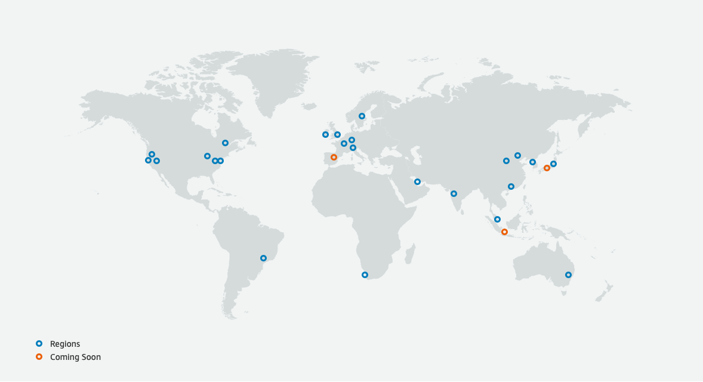
AWS Regions
Accurate per 2020.05.30
Notes:
“So what is AWS?… Well, physically AWS is a global network of data centers…”
Global Infrastructure:
24 Regions
76 AZs
Announced:
3 More regions
9 More AZs.
Region:
Physical Location with two or more AZs
Availability Zone (AZ):
A discrete data center with independent power and internet connections.
Physically separated from another AZ by many KMs, but all within 100 km (60 miles) of each other.
Interconnected with all other regions AZs by high-bandwidth, low-latency connections.
Allows for HA.
AWS Edge Location:
CloudFront Global Edge Network, CDN locations in 216 Points of Presence.
AWS Local Zones:
Only in Los Angeles! More to come.
AWS Local Zones place compute, storage, database, and other select AWS services closer to end-users. With AWS Local Zones, you can easily run highly-demanding applications that require single-digit millisecond latencies to your end-users such as media & entertainment content creation, real-time gaming, reservoir simulations, electronic design automation, and machine learning.
Each AWS Local Zone location is an extension of an AWS Region where you can run your latency sensitive applications using AWS services such as Amazon Elastic Compute Cloud, Amazon Virtual Private Cloud, Amazon Elastic Block Store, Amazon File Storage, and Amazon Elastic Load Balancing in geographic proximity to end-users. AWS Local Zones provide a high-bandwidth, secure connection between local workloads and those running in the AWS Region, allowing you to seamlessly connect to the full range of in-region services through the same APIs and tool sets.

Slide 18



























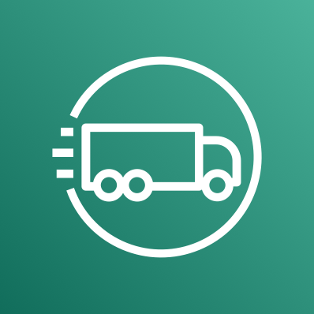


AWS Services
Cloud Computing - Amazon Web Services
Notes:
AWS Services:
EC2
S3
AWS Lambda
ElastiCache
30 Services in total listed. Per 2020, 212 available services.

Slide 19
Amazon S3
Simple Storage Service
Cloud Computing - Amazon Web Services
Object Storage
3 Storage Classes
Unlimited Storage
S3 Replication
99.999999999% Durability
Simple Website Hosting
“Buckets”
Notes:
S3
“There has never been an S1 or S2” Also known as “Simple Storage Service”
Object Storage - You cannot install an OS on S3. Objects only.
Unlimited storage, however, max 5TB per file.
11 9’s of durability - chances of losing data is extremely slim.
Files stored in Buckets
3 Storage Classes
Standard
Infrequent Access
Glacier
Replicate data globally, or within region.
Host static websites directly from bucket.

Slide 20
EC2
Amazon Elastic Compute Cloud
Cloud Computing - Amazon Web Services
Virtual Machines
4 Pricing Models
Placed in an AZ
AMIs
Vertical and Horizontal Scaling
Private or publicly available
Notes:
EC2
Again, there has never been an “EC1”. I hate AWS naming.
Virtual Machines.
An EC2 instance lives in a single AZ.
Can be scaled vertically or horizontally using AWS Auto Scaling
4 Pricing Models
(Most Flexible) On Demand Instances
(Save up to 75%) Reserved Instances
(Cheapest) Spot Instances
(Most Expensive) Dedicated Server
Amazon Machine Images - select your OS and go
Can get a public IP or just a private if you need.

Slide 21
Amazon Aurora
Managed Relational Database
Cloud Computing - Amazon Web Services
MySQL & Postgres Compatible
Instant Replication across 3-AZs
Five times faster than MySQL
Up to 15 read replicas
Distributed, fault-tolerant
Fully Managed

Slide 22
AWS Lambda
Run Code without managing servers
Cloud Computing - Amazon Web Services
Serverless Compute
Subsecond Metering
Pay only for compute time
Multiple language support
Continuous Scaling
Up to 15 minutes per execution
Notes:
AWS Lambda
Automatically runs your code without having to provision or manage servers
No paying for idle-time! Pay only for the execution time.
Supports: Java, Go, Powershell, Python, Node.js, C# and ruby.

Slide 23
AWS Free Tier

Slide 24

Free Stuff!
“What’s in it for me?”
Cloud Computing - Amazon Web Services
EC2
S3
Elastic Beanstalk
OpsWorks
CodeStar
Auto-Scaling
Many, many more

Slide 25
Free AWS Service
Cloud Computing - Amazon Web Services
Always Free
Free Tier

Slide 26
750 Hours
Amazon EC2, Per Month
Notes:
EC2:
750 Hours per month of T3.Micro
How you use that time, is up to you - 10 Instances for 75 hours or 1 instance for 750 hours - up to you…

Slide 27
750 Hours
Amazon RDS, Per Month
Notes:
RDS:
750 Hours per month of T3.Micro
How you use that time, is up to you - 10 Instances for 75 hours or 1 instance for 750 hours - up to you…
Does NOT include Aurora!!!

Slide 28
5 GB
Amazon S3, Per Month

Slide 29
1 Million
Amazon Lamdba Requests, Per Month
Notes:
Lambda:
Up to 3.2 million seconds of compute time per month

Slide 30

Questions?
mathiasmoberg
kmoberg
Bergen Cloud User Group - 2020.09.15

